Slide 1

Text Classification with Naive Bayes
William Lee
CSC 44700 Machine Learning
Fall 2020

Slide 2
Steps for Text Classification
Obtain & clean the data
Tokenize data into a bag of words
Provide weight to the bag of words
Train and test the model using Naive Bayes Classifier
Analyze the results

Slide 3
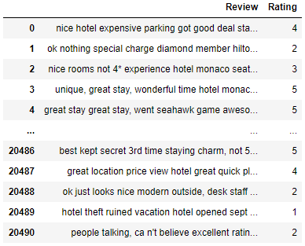
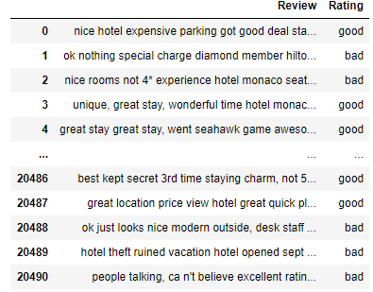
Obtain Data
Data set: Trip Advisor Hotel Reviews from Kaggle
Classification: Good (5 – 4 star), Bad (3 - 1 star)

Slide 4
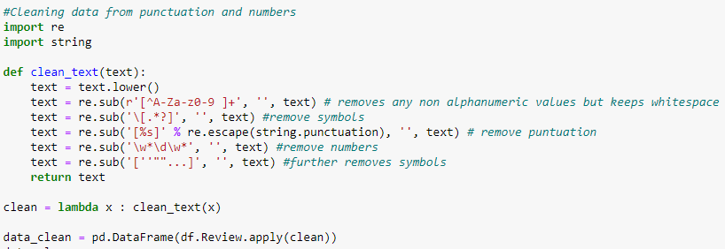
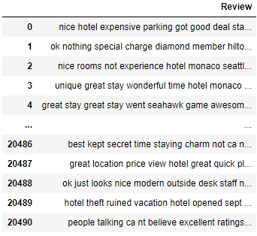
Clean Data

Slide 5
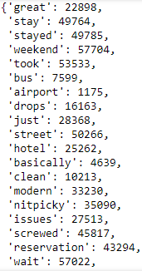

Tokenize Data
Bag of Words
Used CountVectorizer( ) to create a bag of words and counts the frequency of each word from the reviews in the dataset

Slide 6
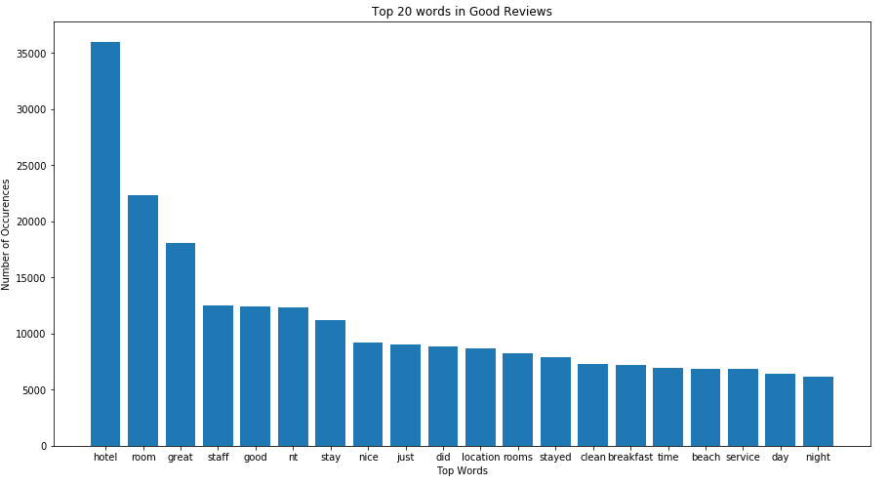
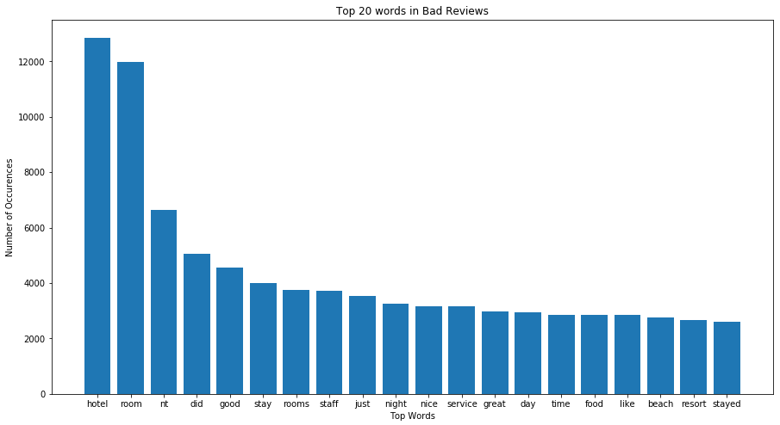
Top words from Good & Bad Reviews

Slide 7
Term Frequency – Inverse Document Frequency (TF-IDF)
Term Frequency : measure the frequency of word in a document
tf (t, d) = count of t in d / number of words in d
Inverse Document Frequency: measures the weight of word t. Words that occur a lot in a document is given less weight such as stop words.
The log of the number of documents divided by the number of documents that contain he word t. idf (t) = log(N/(df ))
Finally, to compute the TF-IDF value for each word
tf-idf(t, d) = tf(t, d) * log(N / (df))

Slide 8

Multinomial Naive Bayes Classifier
Bayes Theorem: P(good | review) = P(review | good) * P(good) / P(review) or
P(bad | review) = P(review | bad) P(bad) / P(review)
Multinomial Naive Bayes, features are generated from a multinomial distribution where it described as the probability of observing counts among a number of categories
$P= \frac{n!}{\left(n1!\right)\left(n2!\right)…(nx!)}$P(1)^{n1}P(2)^{n2}…P(x)^{nx}
n = number of documents
n1… nx = number of occurrence of each document
P(n) = probability of each document

Slide 9
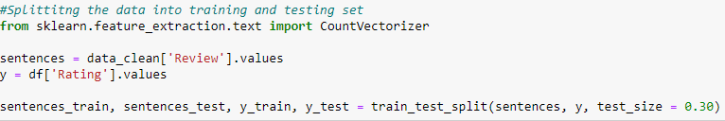
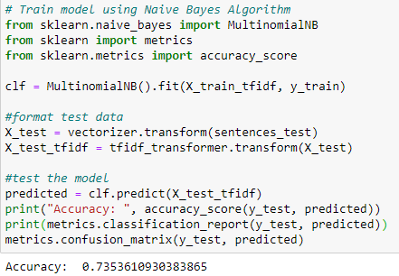
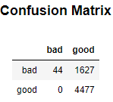
Testing and Training Model
Accuracy: 73.53%
Confusion matrix show that model predicted a bad review to be bad 44 times and good 1627 times

Slide 10


Analyze Results
Dataset is overfitting towards good reviews
Dataset contains typos

Slide 11

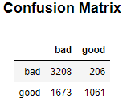
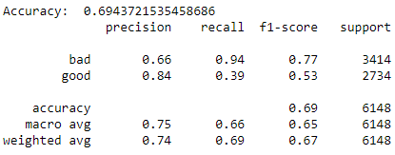
Alternative Model
Changed bad review to be anything lower than 5 stars
Accuracy: 69.43%

Slide 12
Thank you!

